Slide 1
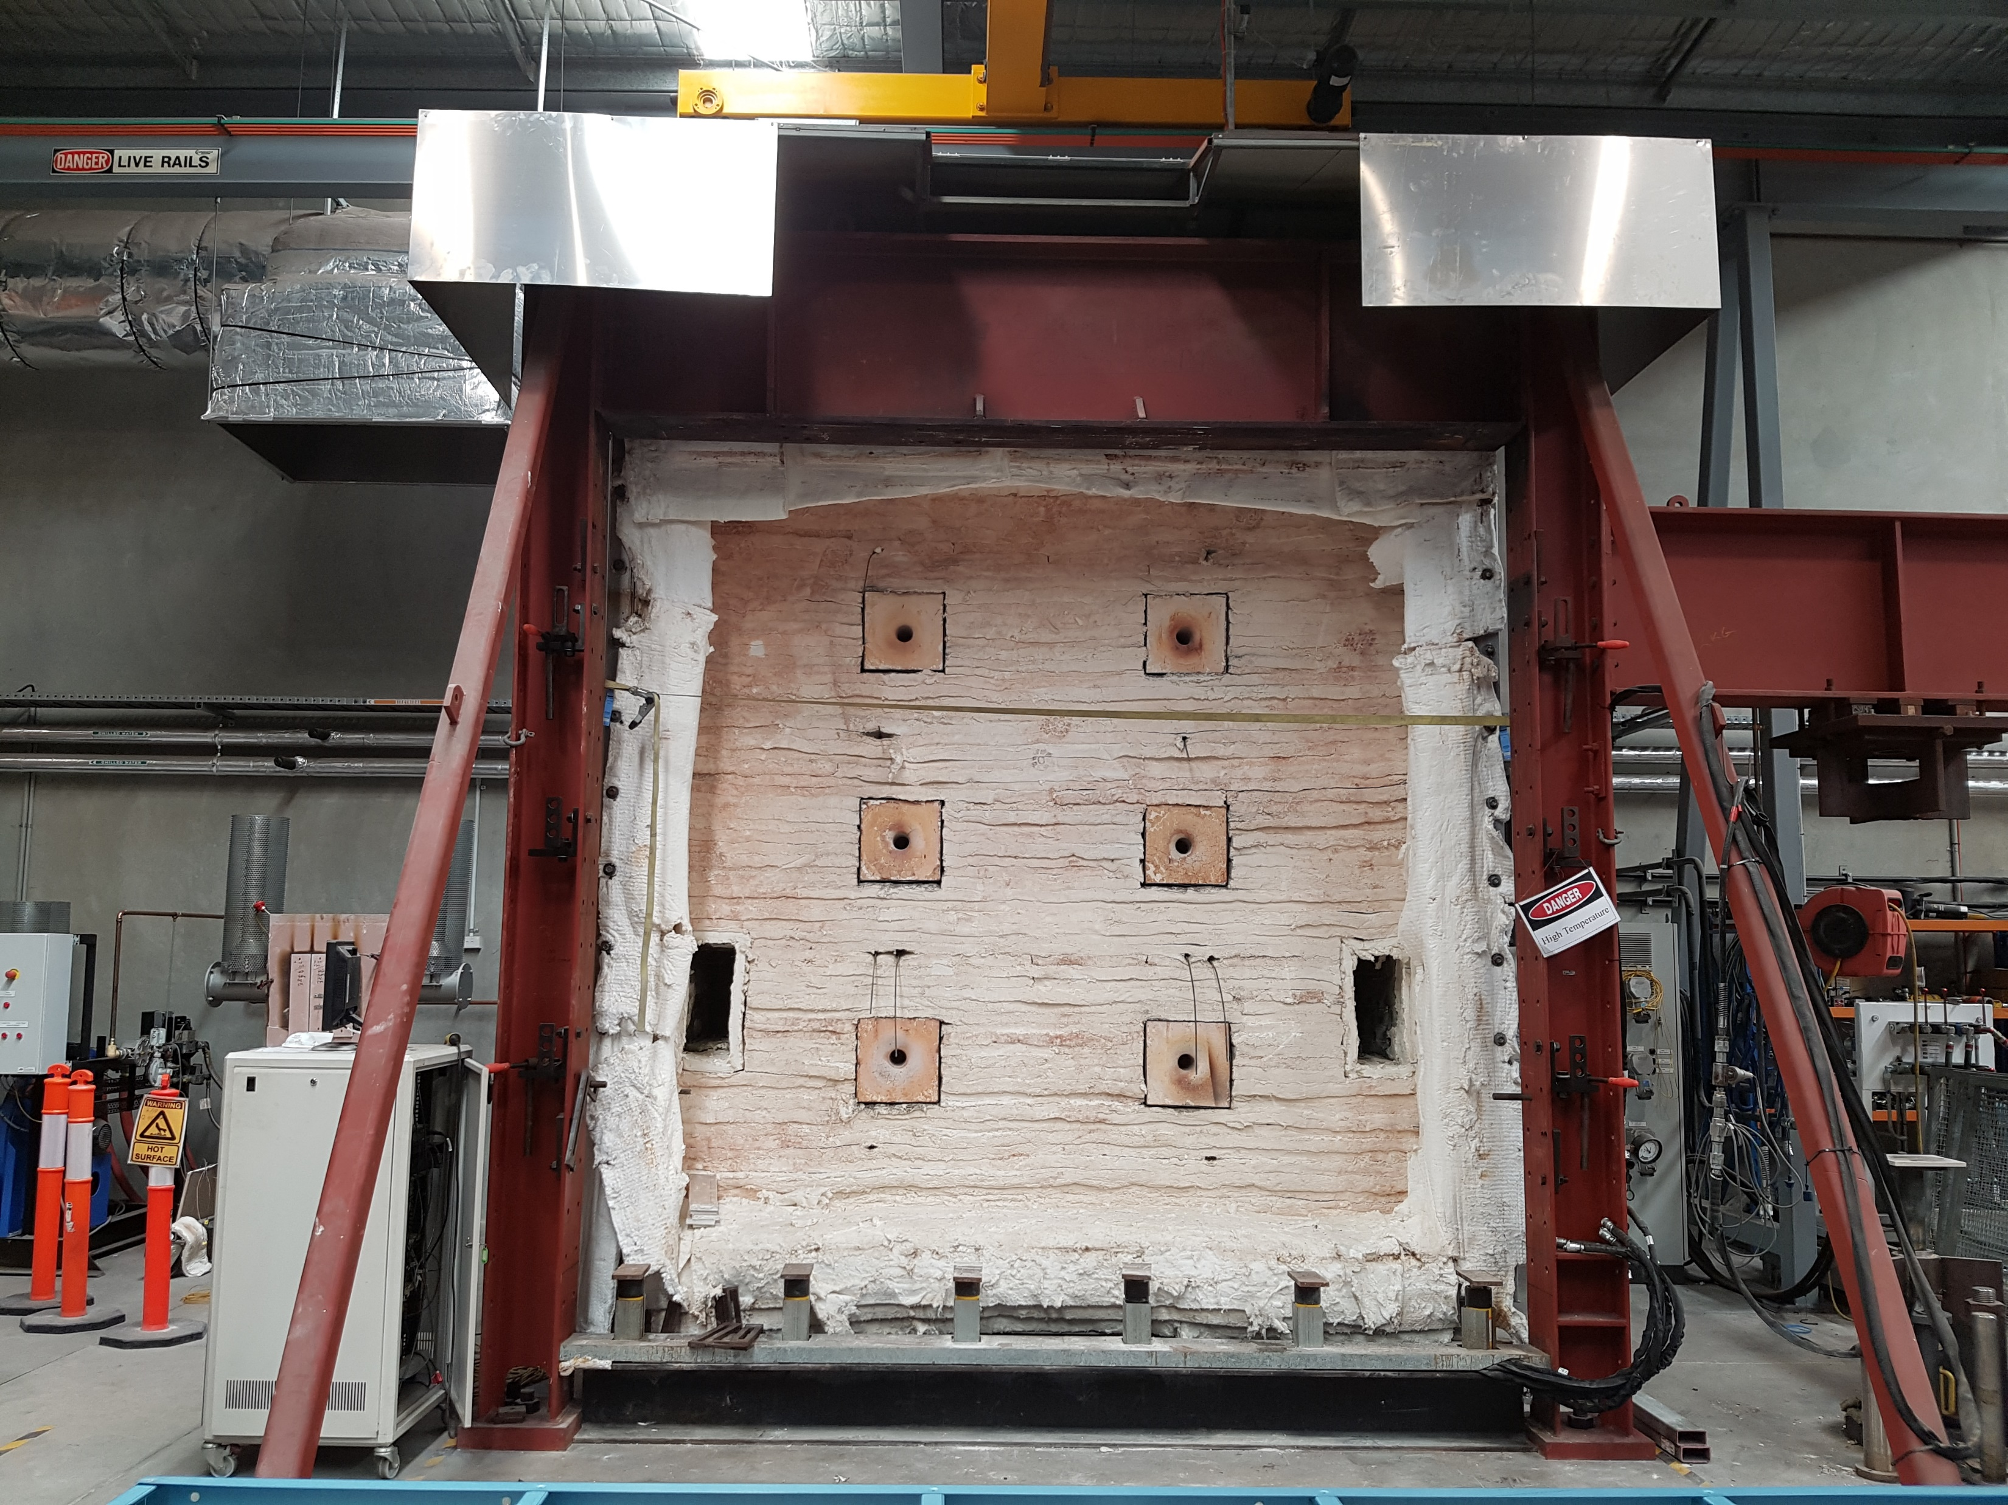
Top Beam (WB)
Universal Column (UC)
Universal Column (UC)
Rams and Loading Plates
Bottom Beam (UB)

Slide 2
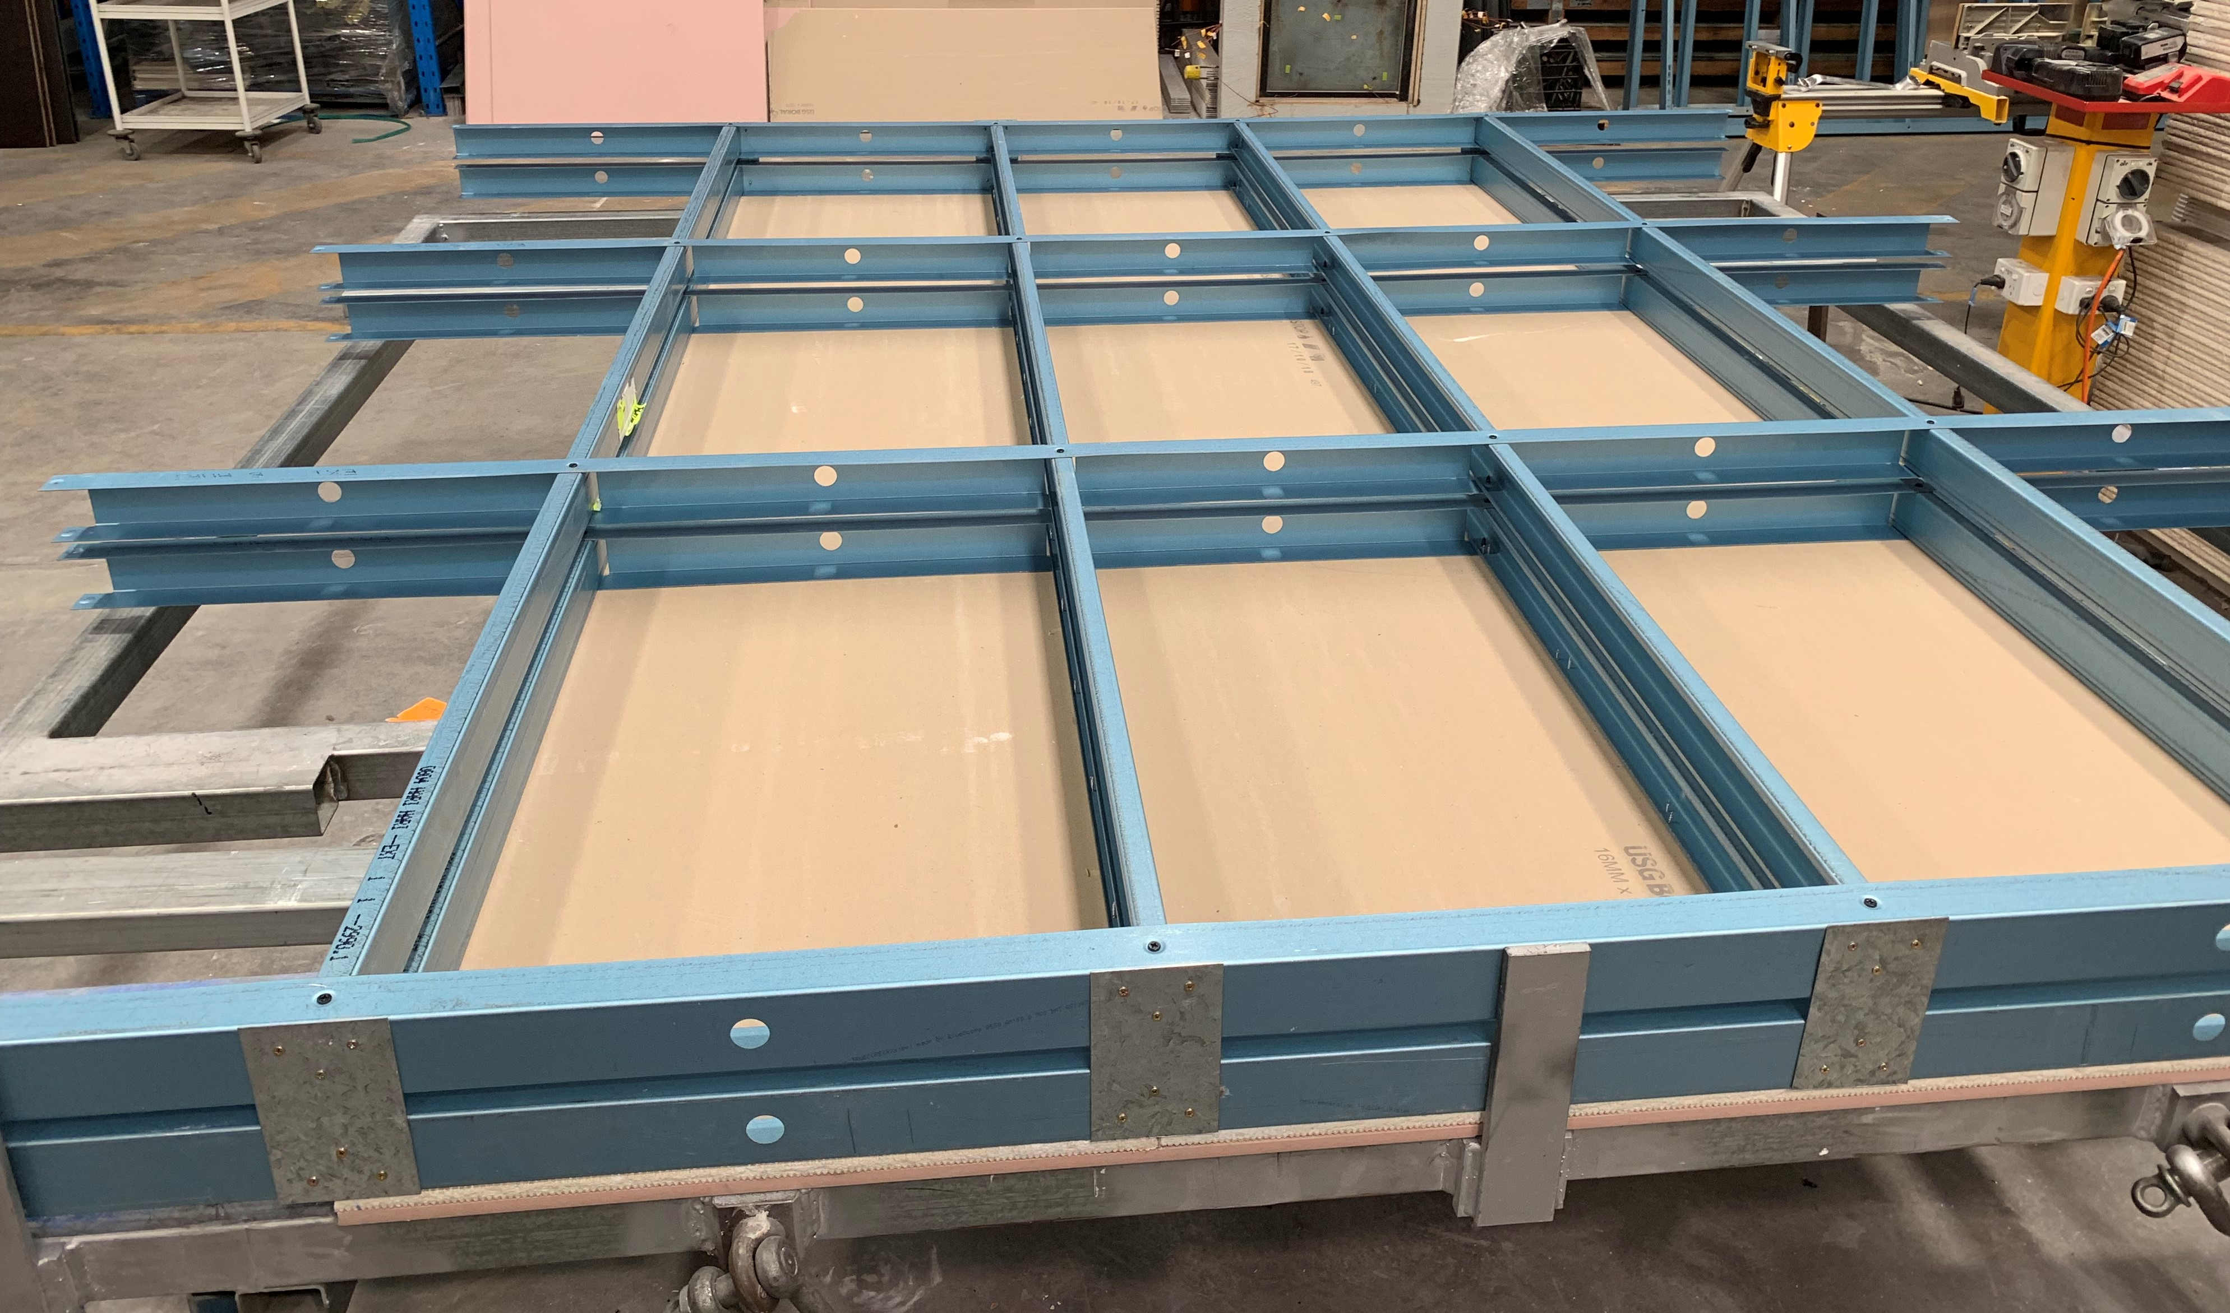
Top
Tracks
Noggings
Noggings
Stud4
Stud3
Plasterboard
Stud2
Stud1
Bottom
Tracks
Spacer Plate

Slide 3
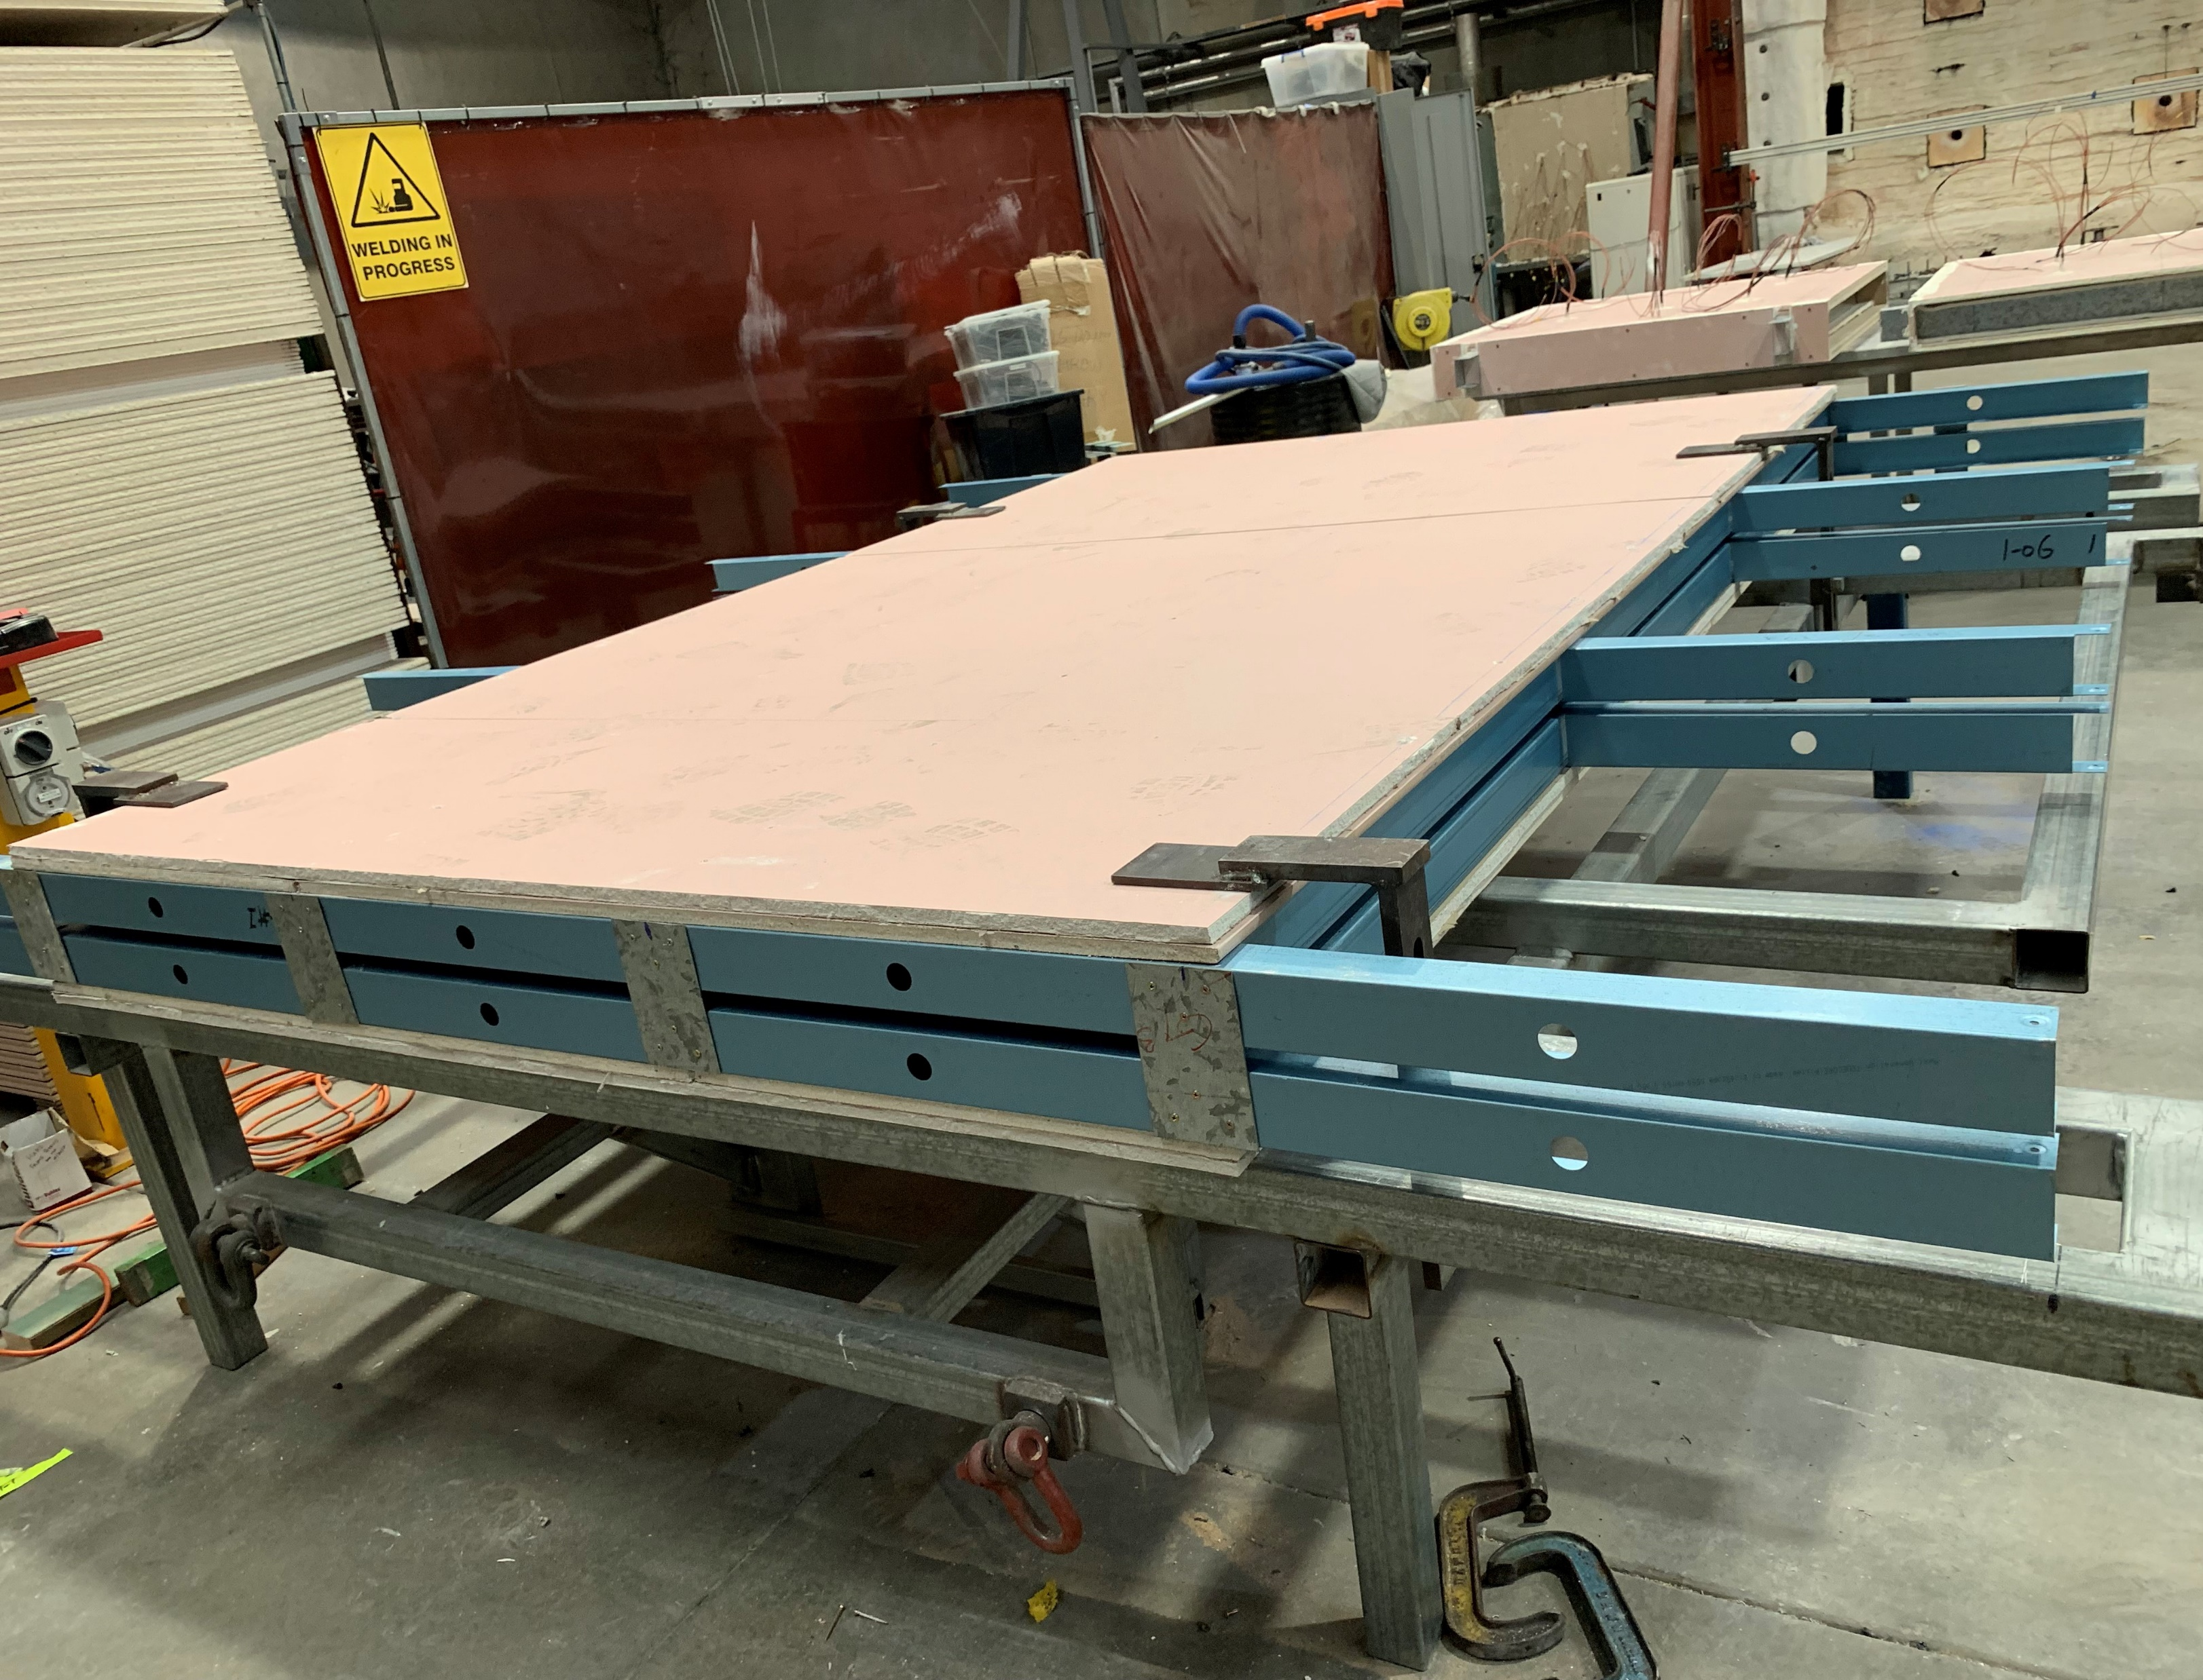
Loading Clamp
Plasterboard
Studs
Spacer Plate
Tracks
Construction Table

Slide 4
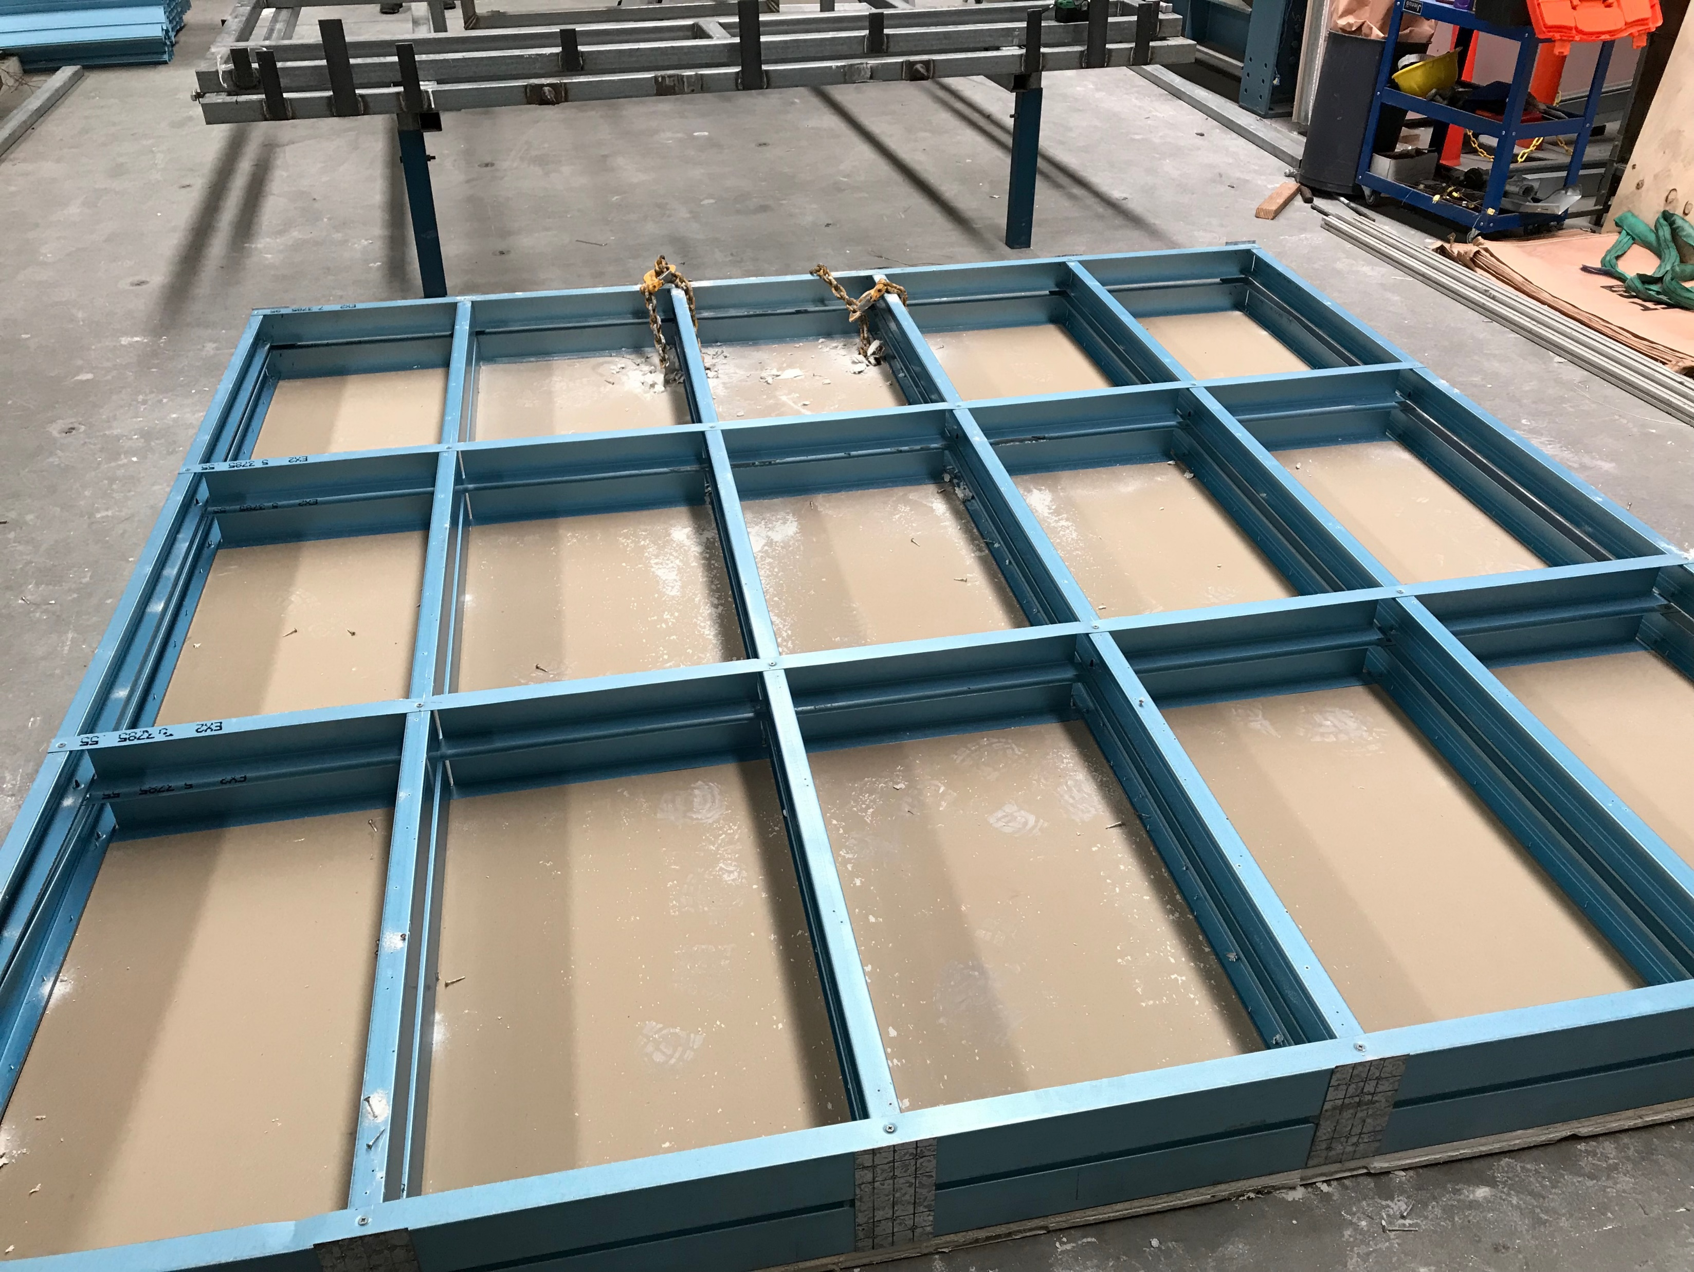
No buckling in other studs
Notes:
AT3-buckling

Slide 5
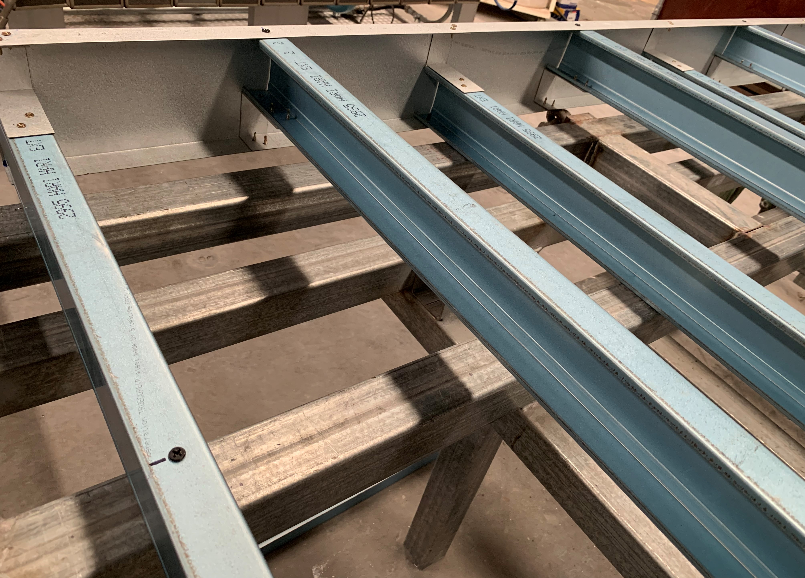
End cleat
300 mm
600 mm
Notes:
AT5-construction

Slide 6
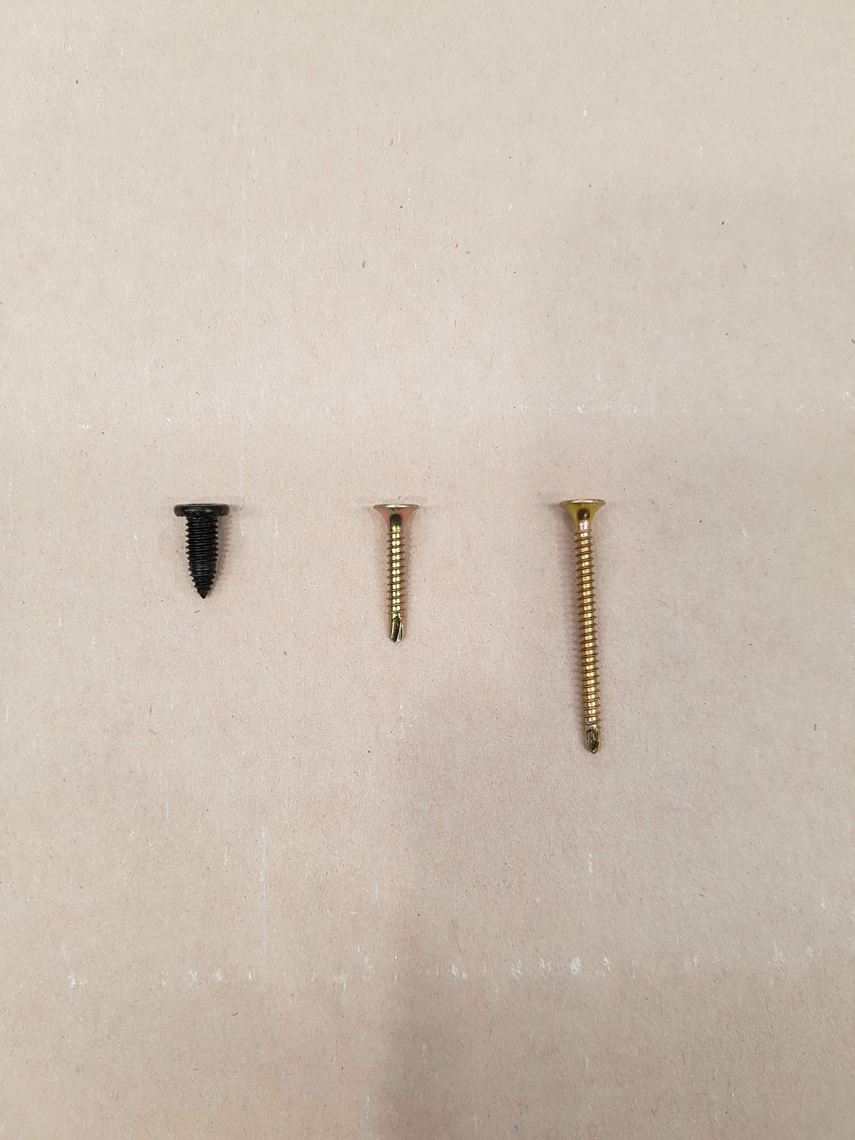
Buildex M6.0 x15 GX Ca
D-Type 10 Ga – 32 mm
D-Type 10 Ga – 45 mm
15 mm
35 mm
45 mm

Slide 7
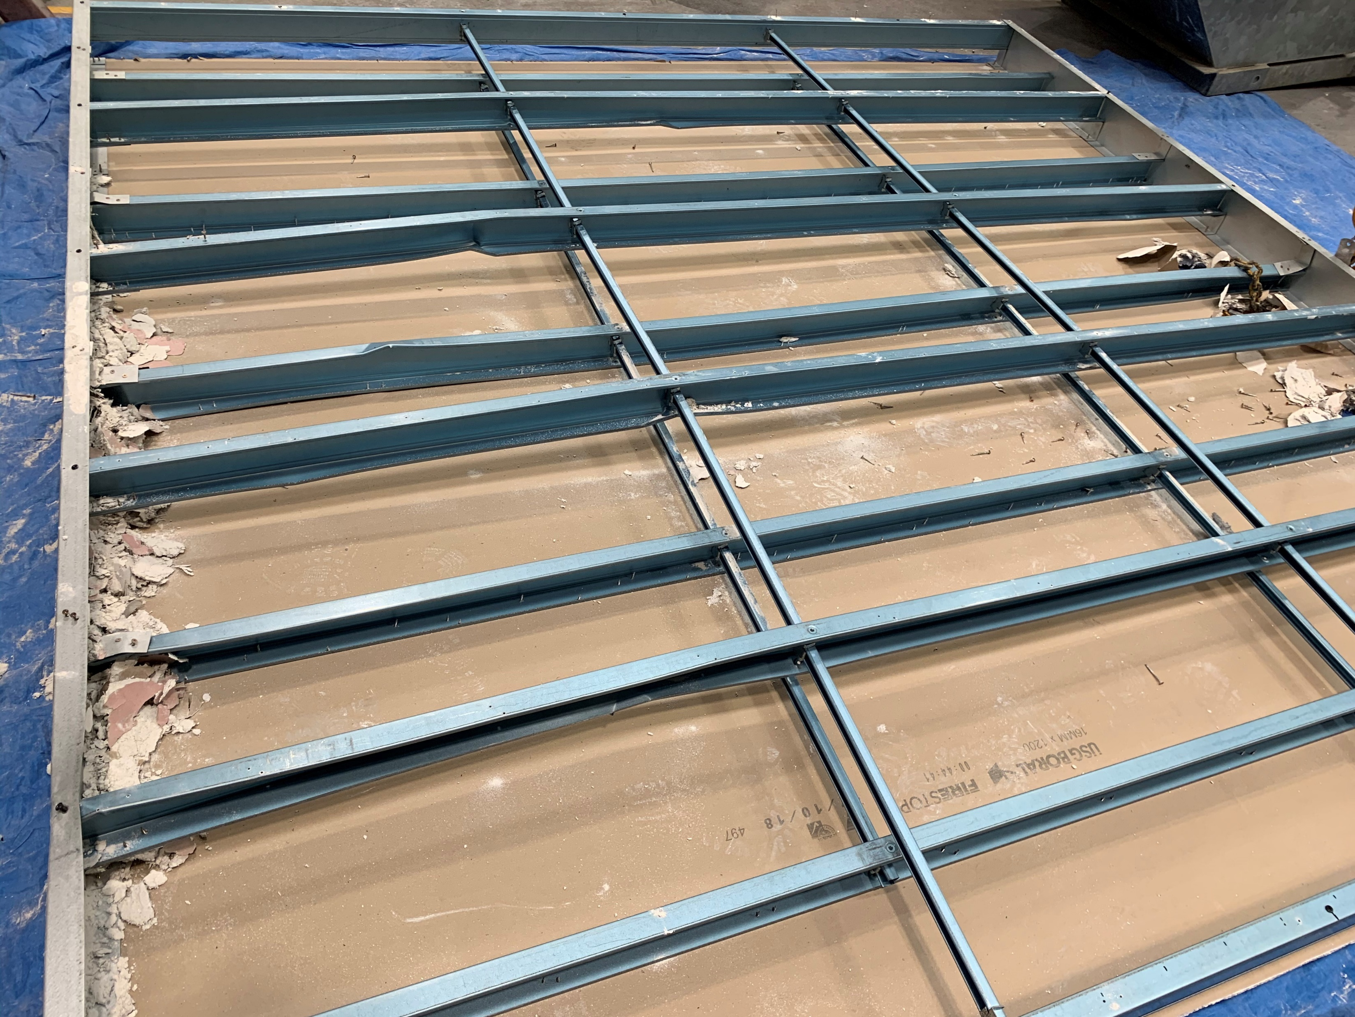
Buckling of studs

Slide 8
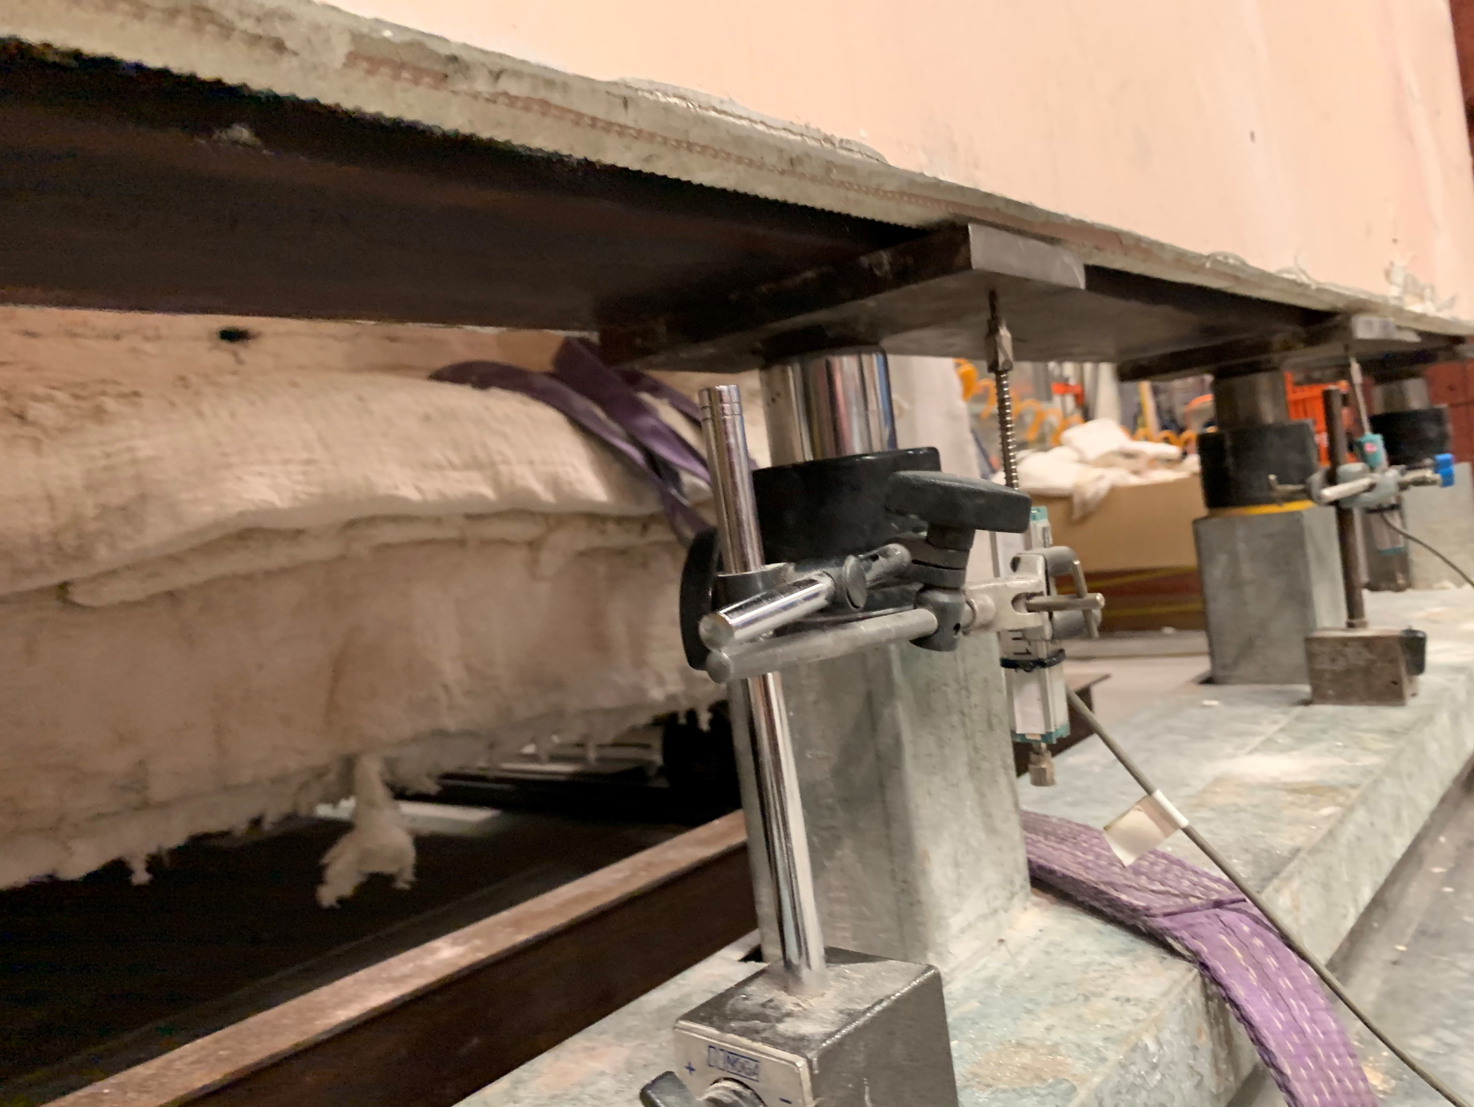
Plasterboard
Bottom loading plate
Bottom loading plate
Bottom end plate
Hydraulic ram
Axial LVDT

